Slide 1
Cumbria Innovation Workshop
Policy Overview
Edward Perchard
Northern Powerhouse team, Cities & Local Growth Unit

Slide 2
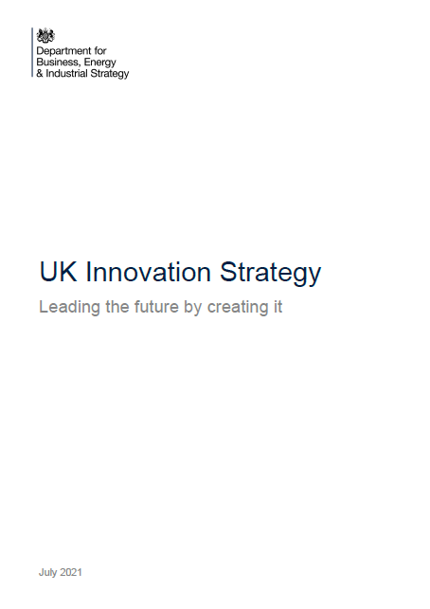
Government has published several strategies over the past year setting the direction of travel of R&D and innovation policy
Plan for Growth
3 March 2021
UK Innovation Strategy
22 July 2021
Levelling Up White Paper
2 February 2022
UKRI Five-Year Strategy
17 March 2022

Slide 3
The Plan for Growth
Government’s plan to Build Back Better after COVID-19 and tackle long-term problems to deliver growth across the UK.
Three core Pillars of Growth
Infrastructure
Skills
Innovation
Three key focuses
Levelling Up
Net Zero
Global Britain
Support and incentivise the development of creative ideas and tech that will shape the UK’s high-growth economy
Support access to finance to help unleash innovation
Develop the regulatory system in a way that supports innovation
Attract the brightest and best people
Support SMEs through Help to Grow Management and Digital

Slide 4
The UK Innovation Strategy sets out Government’s vision to make the UK a global hub for innovation by 2035
It will do this by boosting private sector investment across the UK, creating the right conditions for businesses to innovate. This is key to achieving our goal of increasing total expenditure of R&D to 2.4% of GDP by 2027.
A Vision for 2035
Businesses having the confidence to invest more in innovation because we have optimised the foundations for innovation.
The UK being a magnet for innovation talent from across the world.
Innovation is unleashed across the nation, boosting growth and driving levelling up, because our innovation institutions serve the specific needs of businesses and places across the UK.
The UK is at the forefront of tackling major challenges faced by the UK and the world through our Innovation Missions - pioneering the technologies of tomorrow for healthier and cleaner growth for export to the world’s fastest growing markets
Sets out our plan to make the UK a Global Hub for Innovation by 2035 through action under four pillars:
Unleashing Business
Fuelling businesses who want to innovate by ensuring effective access to private and public investment
People
Creating the most exciting place in the world for talented innovators
Institutions and Places
Ensuring R&D institutions serve the needs of businesses and promoting innovation in places across the UK
Missions and Technologies
Stimulating innovation in technology and missions that will provide the UK with a strategic advantage

Slide 5
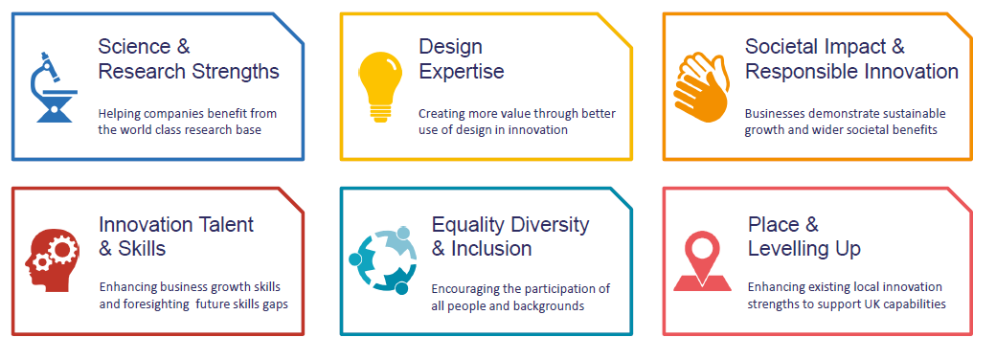
Innovate UK launched a plan for action to explain how it will deliver the UK Innovation Strategy and its vision to make the UK a global hub for innovation

Slide 6
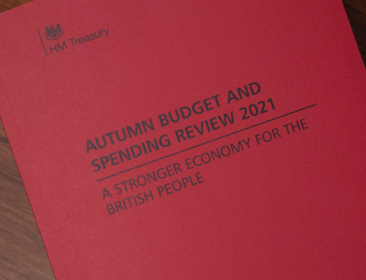
Interlude – Spending Review 21 showed the scale of Government’s commitment to R&D. Public spending on R&D is increasing by £5 billion per annum to £20 billion in 2024/25.
Increased funding for core Innovate UK programmes – c. £1bn per year by 2024/25 – over 300m more per annum than 2021/22.
Recommitment to increasing public expenditure on R&D to £22bn – helping to meet 2.4% target.
Lays a strong foundation for ambition to make the UK a global draw for business and talent and boost private sector investment across the UK.

Slide 7
The Levelling Up White Paper sets out Government’s mission to increase public R&D investment over the next decade
By 2030, domestic public investment in R&D outside the Greater South East will increase by at least 40%, and over the Spending Review period by at least one third. This additional government funding will seek to leverage at least twice as much private sector investment over the long term to stimulate innovation and productivity growth.
R&D is key to accumulating capital, generating business innovation and improving productivity. R&D-rich economies, both nationally and sub-nationally, are more prosperous in the long-run.
Gross R&D spending is currently unevenly distributed across the UK, with 54% taking place in London, the South East and the East of England. A share that has been rising over the last five years.

Slide 8
The LUWP also signals the importance of later-stage R&D – such as the increase in Innovate UK's budget – in making a tangible difference in places
The LUWP includes a number of commitments towards the 2030 R&D target, supporting the Innovation Strategy’s approach to ‘unleashing private investment across the UK
BEIS R&D settlement – aim to invest at least 55% of its R&D funding outside of the GSE by 2024/25. Key is we want it to drive change across the whole organisation.
Give UKRI a new organisational objective to ‘deliver economic, social and cultural benefits from research and innovation to all of our citizens’
Greater focus on innovation alongside research - 36% real-terms increase for Innovate UK annual core funding between 2021-22 and 2024-25, amounting to a cash total of at least £2.5bn over the SR21 period.
Collaboration to increase share of regional funding: Support the growth of R&D hotspots across the UK, including collaboration between national funders, local leaders, private sector and research institutions.
Factor Levelling Up into investment decisions for R&D infrastructure and facilities
Local leadership - Innovation Accelerator pilots in Greater Manchester, Glasgow and West Midlands
Sub-national data on R&D spending – ONS, GO-Science, Spatial Data Unit

Slide 9
Innovation commitments in the Levelling Up White Paper aren’t just from BEIS and UKRI
Defra
Will spend £75m on Net Zero-related R&D in Defra sectors over the next three years
Will spend £140m over three years to scale up Natural Capital and Ecosystem Assessment, in addition to the current Farming Innovation Programme
Up to £24m will be spent on the science and innovation pillar of the UK Seafood Fund
DfT
Will harness its £299m R&D settlement for decarbonising transport to trial zero-emissions road freight, invest in maritime emissions reductions around major ports and leverage private investment into decarbonise transport schemes
This investment will grow R&D strengths across all parts of the UK
DHSC
National Institute for Health Research will bring clinical and applied research to under-served areas
New contractual period for NIHR Biomedical Research centres to see increased levels of non-Golden Triangle investment
Review the NIHR Clinical Research Network funding formula
Commit that at least 50% of new NIHR Clinical Research Facility funding (up from 45%) goes to NHS organisations outside Golden Triangle
MOD
Continue to increase spending outside GSE, including through implementation of Defence and Security Industrial Strategy
Expand regional footprint of Defence Science & Technology Laboratory, including a Science & Technology Experimentation Hub in Newcastle in 2022
Increase geographic diversity of Extra Mural Research
The Defence and Security Accelerator will use a £3.1m Regional Partnerships Fund to target regional innovators

Slide 10
The UKRI five-year strategy sets out the strategic objectives of UKRI
Places and Levelling Up – delivering economic, social and cultural benefits from R&I across the UK and driving change across the whole organisation.
Enhancing the growth of clusters of R&I excellence and innovation ecosystems that build on regional strengths and enable local economic growth and social benefits
Supporting development of evidence to inform regional and national policies and interventions to address regional disparities
Engaging with place-based actors and communities to help shape work
Doing more to understand and evaluate geographic distribution and impacts of UKRI actions and investments
Working in partnership with devolved research, enterprise and HE funding bodies

Slide 11
The LUWP’s 2030 R&D mission is both a significant commitment from HMG to increase public R&D investment outside the South East and to leverage significant amounts of private R&D investment too.
By 2030, domestic public investment in R&D outside the Greater South East will increase by at least 40%, and over the Spending Review period by at least one third. This additional government funding will seek to leverage at least twice as much private sector investment over the long term to stimulate innovation and productivity growth.
Government is keen to hear from business about what it would take to achieve that leverage in the long-run.
If you have any questions or would like to be put in contact with the appropriate team please contact me on edward.perchard@beis.gov.uk.

